Slide 1



Online Movie Ticket Booking
Booking movie tickets online has revolutionized the entertainment industry. With a few clicks, you can secure seats for the latest blockbuster, avoiding long queues and ensuring a seamless moviegoing experience.

Slide 2

Introduction
Online movie booking platforms provide a convenient and efficient way for movie enthusiasts to plan their cinematic adventures. These intuitive systems allow users to browse showtimes, select their preferred seats, and complete the transaction with ease, all from the comfort of their own devices.

Slide 3
Modules/Functions
Film Selection
Seat Selection
Payments and Ticketing
Users can browse a comprehensive database of current and upcoming movie releases, read synopses, and trailers to help them decide which film to watch.
The seating chart allows customers to visualize the auditorium layout and choose their preferred seats, ensuring a more immersive and personalized experience.
Secure payment gateways enable users to purchase tickets seamlessly, while digital tickets can be easily accessed and displayed on their devices.

Slide 4

Expected Results
1
Increased Convenience
2
Better Seat Selection
Online movie booking eliminates the need to visit the theater physically, saving time and effort for busy individuals.
Customers can choose their preferred seats, ensuring they enjoy the best possible view of the screen.
3
Reduced Waiting Times
4
Personalized Recommendations
By pre-purchasing tickets, moviegoers can bypass queues and proceed directly to the auditorium, enhancing their overall experience.
Platforms may offer personalized movie suggestions based on user preferences and viewing history, helping them discover new titles.

Slide 5



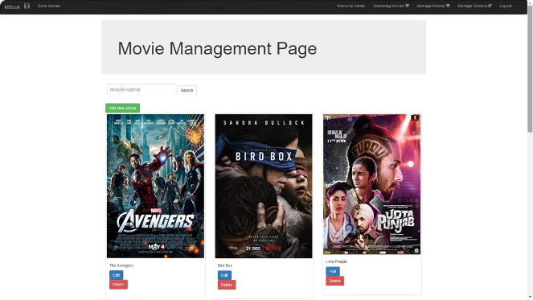


Conclusion
Convenience
Online movie booking offers a seamless and efficient way to plan and secure movie tickets.
Choice
Customers can explore a wide range of movie options and choose their preferred seats and showtimes.
Time-Saving
The ability to book tickets in advance reduces waiting times and enhances the overall moviegoing experience.
Personalization
Customized recommendations and features cater to the unique preferences of each user.

